Slide 1
Model: Machine Learning Pipelines
Pravin Y Pawar
Extracted from
Three Levels of ML Software

Slide 2
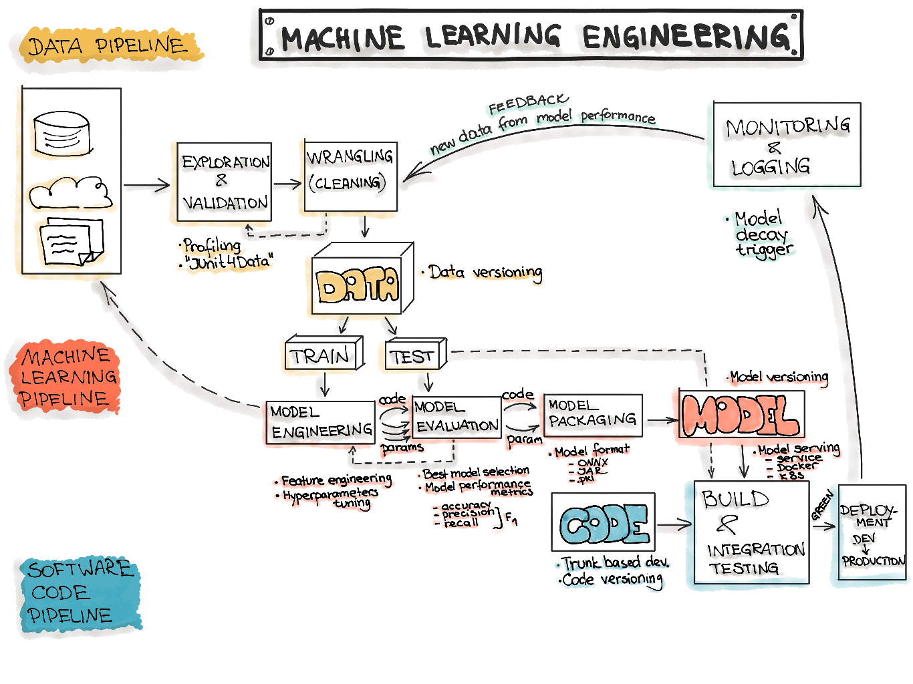
Machine Learning Workflow

Slide 3
Model: Machine Learning Pipelines
The core of the ML workflow is the phase of writing and executing machine learning algorithms to obtain an ML model
The model engineering pipeline is
usually utilized by a data science team
includes a number of operations that lead to a final model
Operations include
Model Training
Model Evaluation
Model Testing
Model Packaging
Recommended to automate these steps as much as possible!

Slide 4
Model Training
Feature engineering
The process of applying the machine learning algorithm on training data to train an ML model
includes feature engineering the hyperparameter tuning for the model training activity
Feature engineering might include:
Discretize continuous features
Decompose features (e.g., categorical, date/time, etc.)
Add transformations of features (e.g., log(x), sqrt(x), x2, etc.)
Aggregate features into promising new features
Feature scaling: Standardize or normalize features
New features should be added quickly to get fast from a feature idea to the feature running in production

Slide 5
Model Training(2)
Model Engineering
Might be an iterative process and include the following workflow:
Every ML model specification (code that creates an ML model) should go through a code review and be versioned.
Train many ML models from different categories
(e.g., linear regression, logistic regression, k-means, naive Bayes, SVM, Random Forest, etc.) using standard parameters
Measure and compare their performance
For each model, use N-fold cross-validation and compute the mean and standard deviation of the performance measure on the N folds.
Error Analysis
analyze the types of errors the ML models make.
Consider further feature selection and engineering
Identify the top three to five most promising models, preferring models that make different types of errors.
Hyperparameters tuning by using cross-validation.
Consider Ensemble methods such as majority vote, bagging, boosting,
Combining ML models should produce better performance than running them individually

Slide 6
Model Evaluation, Testing and Packaging
Model Evaluation
Validate the trained model to ensure it meets original business objectives before serving the ML model in production to the end-user
Model Testing
Once the final ML model is trained, its performance needs to be measured
by using the hold-back test dataset to estimate the generalization error by performing the final “Model Acceptance Test”
Model Packaging
The process of exporting the final ML model into a specific format (e.g. PMML, PFA, or ONNX)
which describes the model to be consumed by the business application

Slide 7
ML Model serialization formats
Various formats to distribute ML models
In order to achieve a distributable format, the ML model should be present and should be executable as an independent asset
means that the ML models should work outside of the model-training environment
Two flavors
Language-agnostic exchange formats
Vendor-specific exchange formats
Language-agnostic exchange formats
Amalgamation is the simplest way to export an ML model as portable - model and all necessary code to run are bundled as one package
Usually, a single source code file that can be compiled on nearly any platform as a standalone program
Create a standalone version of an ML model by using SKompiler to transform trained Scikit-learn models into other forms,
such as SQL queries, Excel formulas,
Portable Format for Analytics (PFA) files
or SymPy expressions - translated to code in a variety of languages, such as C, Javascript, Rust, Julia, etc.

Slide 8
ML Model serialization formats(2)
Commom Language-agnostic exchange formats
PMML
format for model serving based on XML with the file extension .pmml - standardized by the Data Mining Group (DMG)
Basically, .ppml describes a model and pipeline in XML
The PMML supports not all of the ML algorithms, and its usage in open source-driven tools is limited due to licensing issues
PFA (Portable Format for Analytics) - designed as a replacement for PMML
is a string of JSON-formatted text that describes an executable called a scoring engine
each engine has a well-defined input, a well-defined output, and functions for combining inputs to construct the output in an expression-centric syntax tree
To run ML models as PFA files, need a PFA-enabled environment
ONNX (Open Neural Network eXchange)
ML framework independent file format
created to allow any ML tool to share a single model format - supported by many big tech companies such as Microsoft, Facebook, and Amazon
Once the ML model is serialized in the ONNX format,
can be consumed by onnx-enabled runtime libraries (also called inference engines)and then make predictions

Slide 9
ML Model serialization formats(3)
Vendor-specific exchange formats
Scikit-Learn
saves models as pickled python objects, with a .pkl file extension
H2O
allows to convert the models to either POJO (Plain Old Java Object) or MOJO (Model Object, Optimized)
SparkML models
can be saved in the MLeap file format and served in real-time using an MLeap model server
The MLeap runtime is a JAR that can run in any Java application
supports Spark, Scikit-learn, and Tensorflow for training pipelines and exporting them to an MLeap Bundle
TensorFlow
saves models as .pb files; which is the protocol buffer files extension
PyTorch
serves models by using their proprietary Torch Script as a .pt file
can be served from a C– application
Keras
saves a model as a .h5 file, which is known as a data file saved in the Hierarchical Data Format (HDF)- contains multidimensional arrays of data
Apple
has its proprietary file format with the extension .mlmodel to store models embedded in iOS applications
The Core ML framework has native support for Objective-C and Swift programming languages
Applications trained in other ML frameworks, such as TensorFlow, Scikit-Learn, and other frameworks need to use tools like such as coremltools and Tensorflow converter to translate their ML model files to the .mlmodel format for use on iOS

Slide 10
Thank You!
In our next session:

